Slide 1

Daily Review
Reminder:
Distance: how far an object travels Displacement: the change in position and the direction of movement
Describing Distance and Displacement
Draw a diagram to represent the situation. Calculate the distance travelled. Identify or calculate the displacement, including direction.
In a 100 m race, a runner runs 10 m north up the track, before being called back after a false start. The race is restarted and the runner completes the race. What is their displacement and the distance they ran?
The distance the runner travelled is 120 m.
The displacement of the runner is 100 m north.
100 m north
10 m north
10 m south

Slide 2
Daily Review
Reminder:
Time is on the x-axis Displacement is on the y-axis
Drawing Displacement-Time Graphs
Draw, number and label the x-axis. Draw, number and label the y-axis Plot the position of the object, connecting each point with a straight line.
Draw a graph to show the following motion.
A bird takes 1 second to fly 10 m from its nest to a bird bath. It stops for 1.5 s to drink some water, then flies a further 30 m to collect a twig, which takes 2.5 s. The bird then takes 3 s to return to its nest.
40
30
20
10
Displacement (m)
0
-10
1
2
3
4
5
6
7
8
Time (seconds)
-20
-30
-40

Slide 3

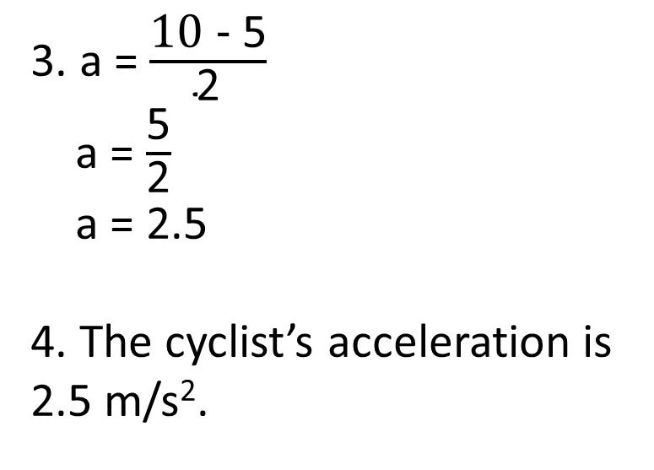
Daily Review
Reminder:
Δv = v – u Change in velocity = final velocity – initial velocity
Calculating Values Related to Acceleration
Write down the information you are given and what you are trying to find. Rearrange the equation to find your unknown. Substitute values into the equation and solve. Add appropriate units.
A cyclist accelerates from 5 m/s to 10 m/s in a time of 2 s. What is their acceleration?
1. a = ?
u = 5 m/s
v = 10 m/s
t = 2 s
2. a = $\frac{\text{Δ}v}{\text{t}}$
3. a = $\frac{\text{10 − }\text{5}}{\text{2}}$
a = $\frac{\text{5}}{\text{2}}$
a = 2.5
4. The cyclist’s acceleration is 2.5 m/s².
(Δv)
velocity change
÷
÷
(a)
acceleration
×
(t)
time

Slide 4
Daily Review
Reminder:
Δv = v – u Change in velocity = final velocity – initial velocity
Calculating Values Related to Acceleration
Write down the information you are given and what you are trying to find. Rearrange the equation to find your unknown. Substitute values into the equation and solve. Add appropriate units.
An object decelerates at – 3 m/s² for a time of 3 seconds? What is its change in velocity?
1. a = – 3 m/s²
u = ?
v = ?
t = 3 s
2. Δv = a x t
3. Δv = – 3 x 3
Δv = – 9
4. The object’s velocity is decreasing by 9 m/s.
(Δv)
velocity change
÷
÷
(a)
acceleration
×
(t)
time

Slide 5
Velocity-Time Graphs Year 10 Physics

Slide 6
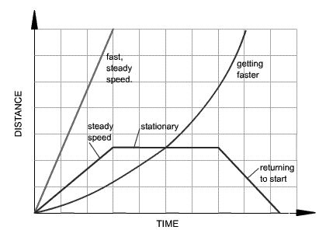
Learning Objectives
CFU
What are we going to learn?
Interpret velocity-time graphs
Calculate displacement from velocity-time graphs.
A
D
Activate Prior Knowledge
Displacement
C
B
On the displacement-time graph, which section shows:
The object is stationary?
The object is moving back to the starting position?
Look at sections A and B. Which one is moving faster? How do you know?
Think, pair, share: What is happening to the object’s motion in section D?
E
Time

Slide 7
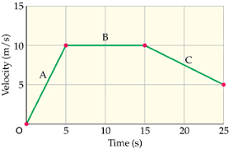
Concept Development
CFU 1
What do velocity-time graphs show?
Velocity-Time Graphs
Velocity-time graphs show the change in velocity over a period of time.
Time is on the x-axis and velocity is on the y-axis.
Velocity-time graphs are useful when describing motion
They can be used to determine the:
velocity at a point in time
acceleration of the object
displacement of the object
CFU 2
Which variable is on the y-axis of the graph?
CFU 3
From the graph, what is the velocity at: 2.5 seconds? 10 seconds? 20 seconds?

Slide 8
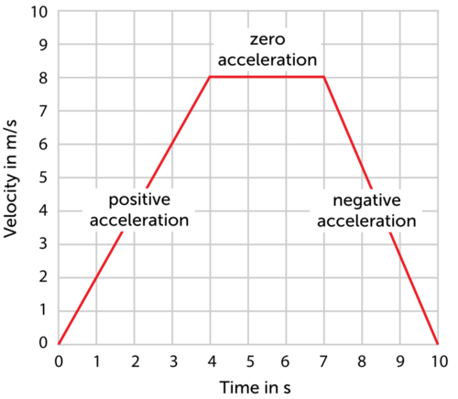
Concept Development
CFU 1
What does the gradient of a velocity-time graph show?
Velocity-Time Graphs
The gradient of the graph shows the change in velocity (acceleration) of the object.
An positive slope shows an increase in velocity.
A negative slope shows a decrease in velocity.
A horizontal line shows a constant velocity.
CFU 2
Which part of the graph shows deceleration?
Constant velocity
CFU 3
In which part of the graph is acceleration zero?
Increasing velocity
Decreasing velocity

Slide 9
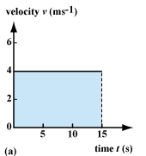
Concept Development
CFU 1
How do we find displacement on a velocity-time graph?
Calculating Displacement Using Velocity-Time Graphs
The area under the line on a velocity time graph is the same as the displacement of the object.
Displacement is calculated using the formula: s = t x v
The blue rectangle on the graph is the area under the line.
If we want to find its area, we multiply the length by the height of the rectangle.
In this case, the length is the time and the height is the velocity, so we end up with time x velocity, which is the same as displacement.
The area of regular shapes can be used to calculate displacement.
CFU 2
In the graph, what is the object’s displacement?
CFU 3
Why are we able to use this method to find displacement?

Slide 10
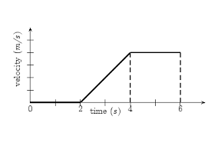
Skill Development/Guided Practice
Reminder: Area
Square / Rectangle = length x height Triangle = ½ base x height
Calculating Displacement from Velocity-Time Graphs
Divide the graph into sections with regular shapes. Calculate the area of each shape. Add the areas of each shape to find the total displacement.
Yellow shape
Length x height = 2 x 4
= 8
Orange shape
½ base x height = ½ x 2 x 4
= 4
Total area = 8 + 4
= 12
What is the displacement of the object in the graph?
5
4
3
2
1
The object’s displacement is 12 m.

Slide 11
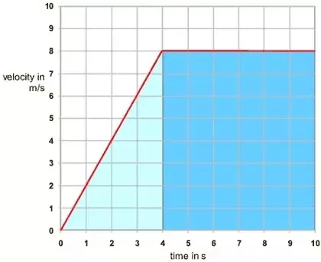
Skill Development/Guided Practice
Reminder: Area
Square / Rectangle = length x height Triangle = ½ base x height
Calculating Displacement from Velocity-Time Graphs
Divide the graph into sections with regular shapes. Calculate the area of each shape. Add the areas of each shape to find the total displacement.
Dark blue shape
Length x height = 6 x 8
= 48
Light blue shape
½ base x height = ½ x 4 x 8
= 16
Total area = 48 + 16
= 64
What is the displacement of the object in the graph?
The object’s displacement is 64 m.

Slide 12

Skill Development/Guided Practice
Reminder: Area
Square / Rectangle = length x height Triangle = ½ base x height
Calculating Displacement from Velocity-Time Graphs
Divide the graph into sections with regular shapes. Calculate the area of each shape. Add the areas of each shape to find the total displacement.
Yellow shape
Length x height = 3 x 8
= 24
Orange shape
½ base x height = ½ x 4 x 8
= 16
Blue shape
½ base x height = ½ x 3 x 8
= 12
Total area = 24 + 16 + 12
= 52
What is the displacement of the object in the graph?
The object’s displacement is 52 m.

Slide 13
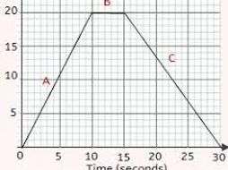
Skill Development/Guided Practice
Reminder: Area
Square / Rectangle = length x height Triangle = ½ base x height
Calculating Displacement from Velocity-Time Graphs
Divide the graph into sections with regular shapes. Calculate the area of each shape. Add the areas of each shape to find the total displacement.
Yellow shape
Length x height = 5 x 20
= 100
Orange shape
½ base x height = ½ x 10 x 20
= 100
Blue shape
½ base x height = ½ x 15 x 20
= 150
Total area = 100 + 100 + 150
= 350
What is the displacement of the object in the graph?
Velocity (m/s)
The object’s displacement is 350 m.

Slide 14
Relevance
Being able to interpret different types of graphs is an important skill in everyday life.
Velocity-time graphs are a simple way to describe the motion of an object. A lot of information can be obtained from a velocity-time graph, including displacement, velocity and acceleration

Slide 15
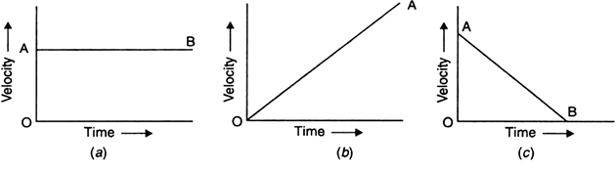
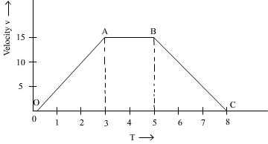
Skill Closure
Which graph shows: increasing velocity?
zero acceleration?
decreasing velocity?
Skill Closure
Calculating Displacement from Velocity-Time Graphs
Divide the graph into sections with regular shapes. Calculate the area of each shape. Add the areas of each shape to find the total displacement.
Explain how we find the displacement of an object using a velocity-time graph.
Skill Closure
Find the displacement of the object in the graph. Assume time is in seconds and velocity is in m/s.

Slide 16
Independent Practice
Complete the worksheet “Acceleration – Speeding up and slowing down” on your device.

